Slide 1


Slide 2

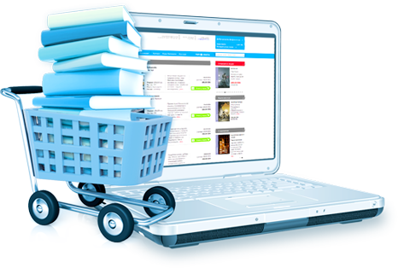
Objective:
This Faculty Book System project developed in JAVA is used as an asset for keeping record of faculty books. Thus it helps in minimising manual work and makes it easy to access and store lists in a simple and efficient manner.

Slide 3
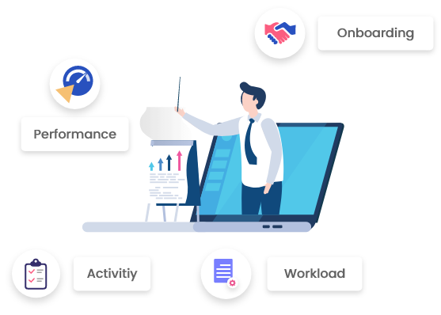
The software is pre-loaded with the list of the faculty and the students. It stores information related to the issue of any particular book to a faculty or a student along with the date of issue and the date of return.

Slide 4

Features:
Faculty Book System features also include adding or removing items from the database. Regular updates can be made in an efficient manner. It spares the college administration long and tedious hours of manual work. Searching through the database is also fairly easy through the find feature of the software. The faculty book details, book details, course details, faculty books list options provide direct means to access the various modules.

Slide 5

Compared to traditional means of using software like Excel and Access to record and store databases, this system provides a hassle free solution to keep the library records safe and intact. One can easily navigate through the records using the Show Previous Record and Show Next Record options on the panel. This easy to use interface which is user-friendly makes any new user to incorporate it in their usual work routines.

Slide 6
Existing System:
Usually the college staffs make use of different word processing software to store and access information. But searching through them makes it a lot difficult to easily maintain them. The problems of data duplicity and data redundancy pose a big threat in such cases. In case of any updating, all the files have to be individually updated with the new data which consumes a lot of time and energy.

Slide 7
Proposed System:
This new user-friendly Faculty Book System software is designed to resolve problems generally associated with the manual and traditional techniques. It clusters information into well defined sections and accordingly stores them as a database. This makes it easy to search, update or delete records and reduce data redundancy and duplicity. One can directly access the faculty book list, the book list, the course list and the faculty book details without having to look up everything. It can be integrated easily with the day to day work pattern. This system minimises the drawbacks faced presently in the existing systems.

Slide 8
Faculty Book System Modules
1) Faculty book details module:– This module takes the details of the books and the course they are recommended for.
2) Book module:– This module contains information of all the books registered with the system including book name, book number, publication, year of publication, edition, retail price, and the type of book, i.e., recommended reading or prescribed.
3) Course module:– This module consists of information about the course number and course name.
4) Faculty book list:– This modules displays the list of all the textbooks available which can be sorted by the course number or by the textbook name.

Slide 9

Technology and Requirements:
Technology Used
-> Java
Software Requirements
-> Java Virtual Machine
Java code for faculty book system
Link
https://projectsgeek.com/2016/01/faculty-book-system-java-project.html
Hardware Requirements
-> Hard Disk – 8 GB.
-> RAM – 1 GB(min).

Slide 10


